Slide 1
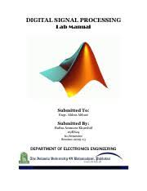







DIGITAL COMMUNICATIONS
Course Code: 23EC2208A
Dr. G V Subbarao
Department of Electronics and Communications Engineering
K L E F Deemed to be University

Slide 2
SYLLABUS
Pulse Modulation Techniques: Baseband signals. Sampling process;
Concepts on PAM, PWM and PPM.
Quantization Process; Quantization Noise;
Linear and Non-linear PCM codes,
Noise Considerations in PCM Systems;
PCM Line Speed,
DPCM,
Delta Modulation (DM)
Adaptive DM.
Line codes.

Slide 3
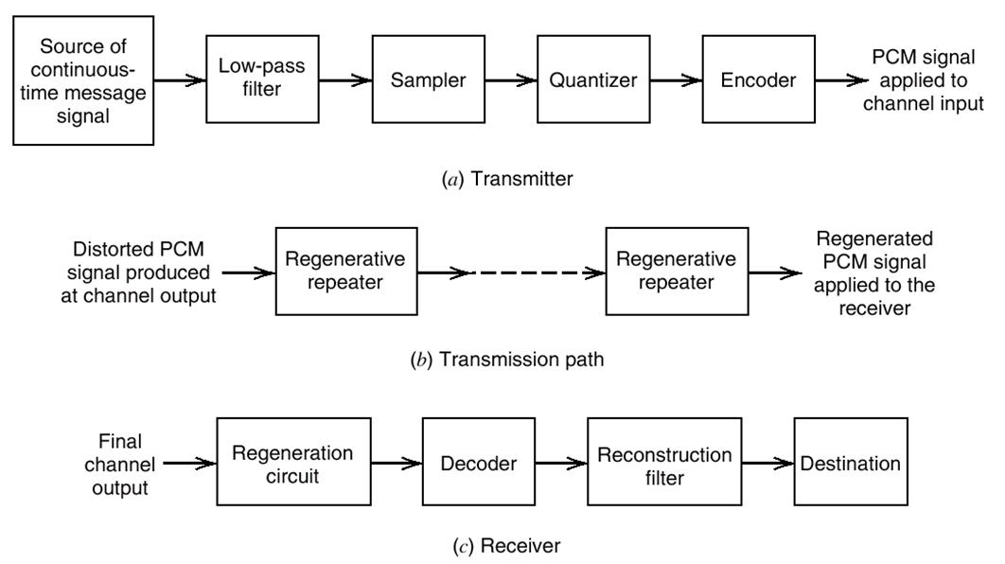

Pulse Code Modulation

Slide 4
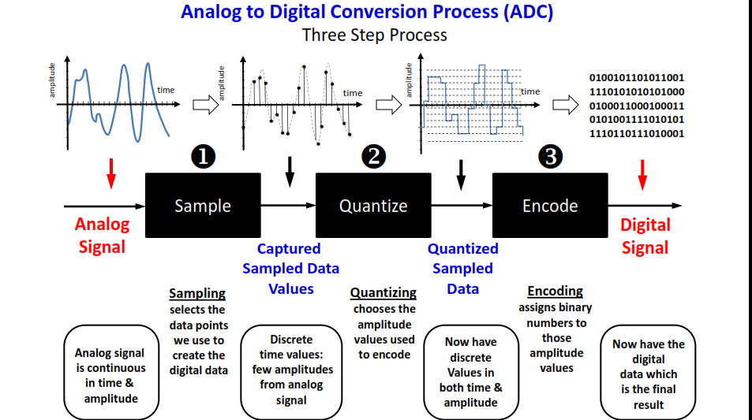
PCM Transmitter

Slide 5
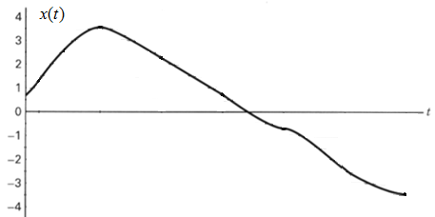
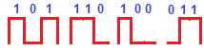
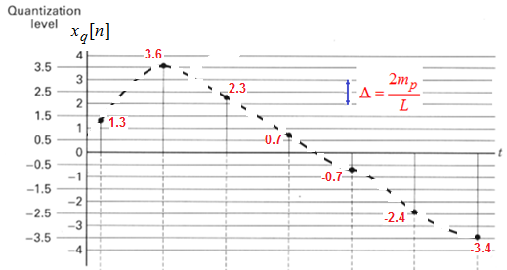
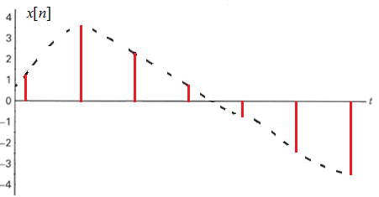
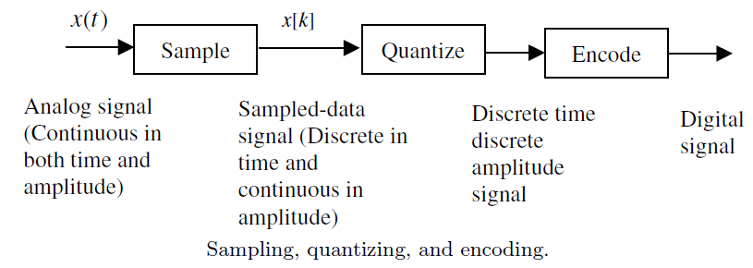
PCM

Slide 6
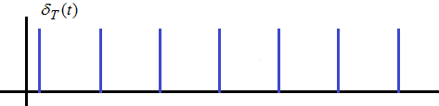
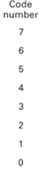
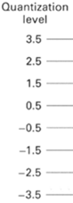
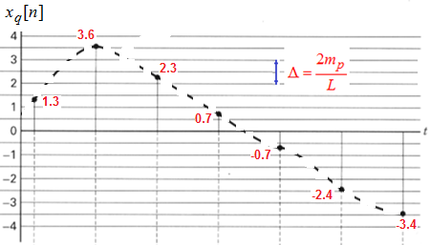
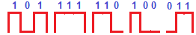
Sampling, Quantization &
Encoding

Slide 7
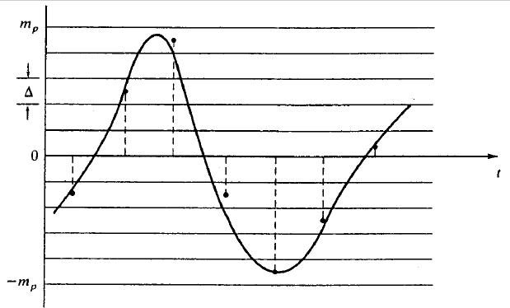
Uniform Quantization
Assume the amplitude of message signal m(t) is confined ti the range (-m_{p},m_{p})
Divide the range uniformly into ‘L’ zones L=2^{n} , Where ‘n’ is the size of the word
Step size of each zone

Slide 8
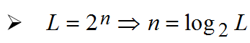
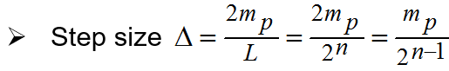
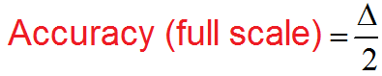
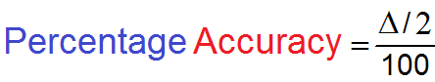
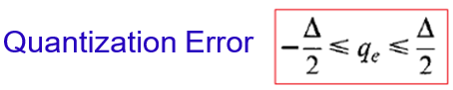
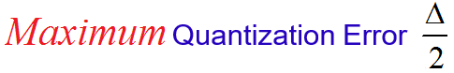
Assigning PCM codes to absolute magnitudes is called Quantizing.
The magnitude difference between adjacent step is called the quantization interval / quantum.
The magnitude of the quantum is also called the resolution Or Step size.
The resolution is equal to the voltage of the minimum step size = Voltage of LSB.

Slide 9
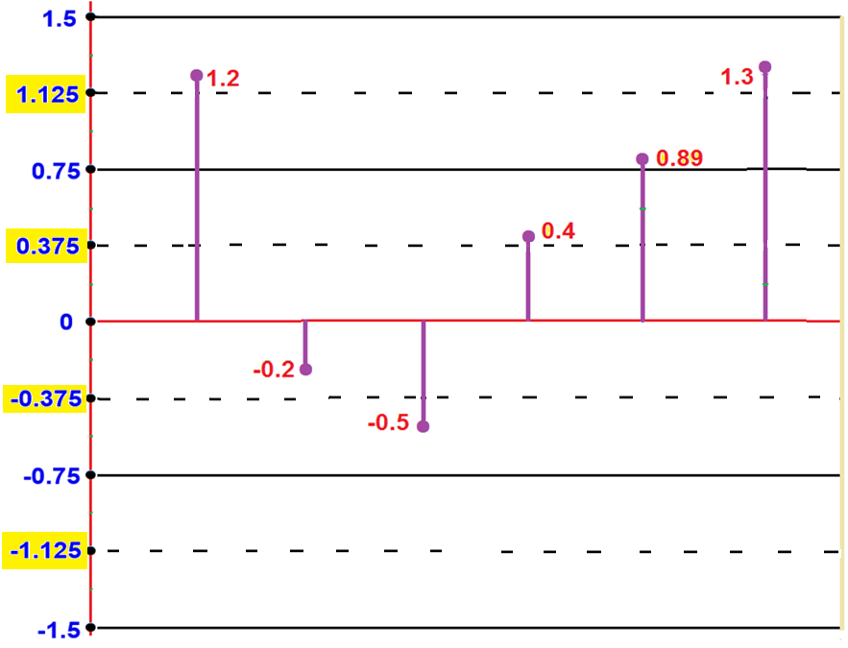
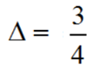

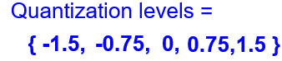
Quantization
Quantize { 1.2, -0.2, -0.5, 0.4, 0.89, 1.3}
11
1.125
1.125
0.125
10
0.375
01
-0.375
-0.375
00
Bit stream representing Encoding: 11 01 01 10 11 11

Slide 10
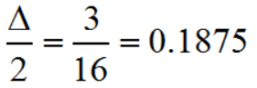
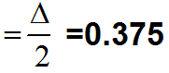
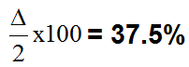
Quantization
the quantization error
Ex1: Quantize a sequence {1.2, -0.2, -0.5. 0.4, 0.89, 1.3} using a uniform quantizer in the range of (-1.5. 1.5) with (i) Four levels (ii) Eight levels, and write the quantized sequences. Determine the quantization error in each case. Write the encoded sequence. Find the full scale accuracy. Find the percentage accuracy.
The full scale accuracy
The percentage accuracy
L=8 Δ=3/8
Quantization levels = { -1.5, -1.3125, -1.125, -0.9375, -0.75, -0.5625, -0.375, 0, 0.375, 0.5625, 0.75, 0.9375, 1.125, 1.3125, 1.5 }
Given Sequence {1.2, -0.2, -0.5. 0.4, 0.89, 1.3}
Therefore the quantized sequence
{1.3125, -0.1875, -0.5625, 0.5625, 0.9375, 1.3125}

Slide 11
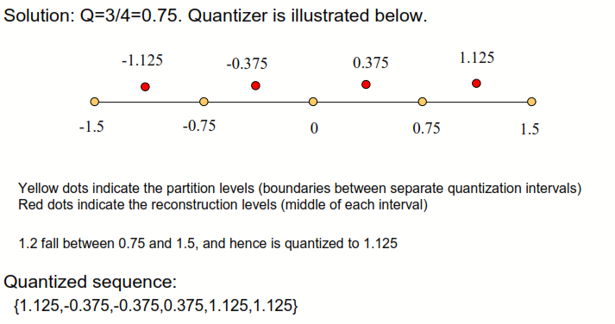
Quantization
For the following sequence {1.2,-0.2,-0.5,0.4,0.89,1.3…}, Quantize it using a uniform quantizer in the range of (-1.5,1.5) with 4 levels, and write the quantized sequence.
Consider a 12 bit uniform quantizer with input range of 10 volts.
Calculate the step size
Maximum quantization error.
Estimate its accuracy and percentage of accuracy
The discrete samples of an analog signal is to be uniformly quantized for PCM system. If the maximum value of the analog sample is to be represented within 0.1% accuracy, find the minimum number of binary digits required.

Slide 12
What is quantization?

Slide 13
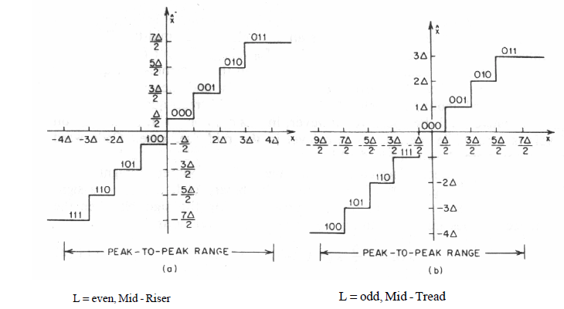
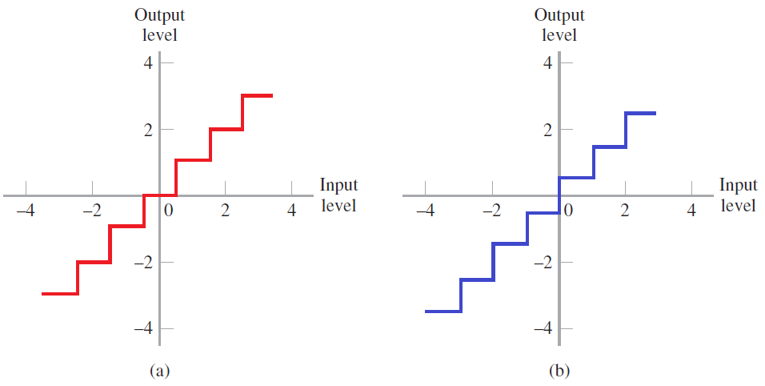
Types of quantization
Mid-Rise
Mid- Tread
Mid-Rise | Mid-tread
origin lies in the middle of a raising part of the stair-case | origin lies in the middle of a tread of the stair-case
Even number of quantization level | Odd number of quantization level
Both the mid-rise and mid-tread type of uniform quantizers are symmetric about the origin

Slide 14

Quantization Noise Estimation:
Assuming error is equally likely in the range
Mean square
(Quantization) error

Slide 15
Noise consideration
The performance of a PCM system is influenced by two major sources of noise.
Channel noise: which is introduced anywhere between the transmitter output and the receiver input, channel noise is always present, once the equipment is switched on.
2. Quantization noise, which is introduced in the transmitter and is carried all the way along to the receiver output.

Slide 16
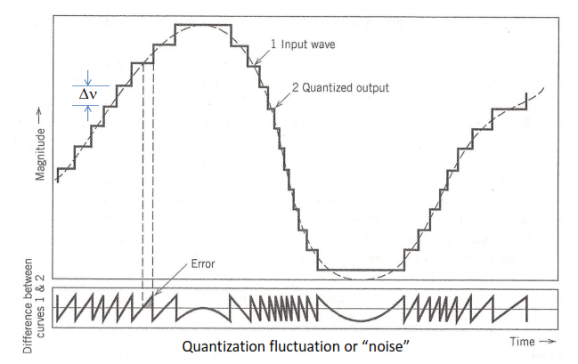
Quantization of a sinusoidal signal

Slide 17
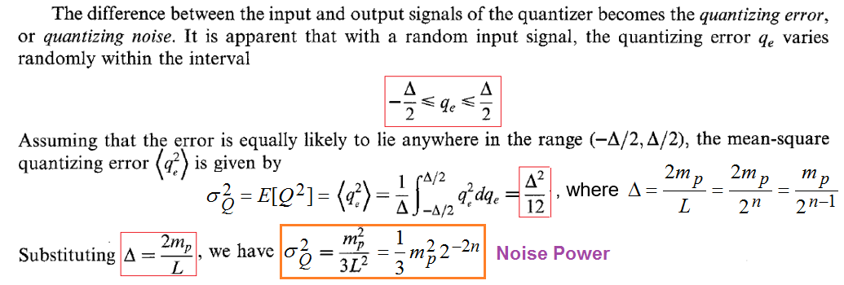
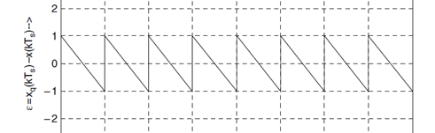
Quantization Error and Noise Power

Slide 18
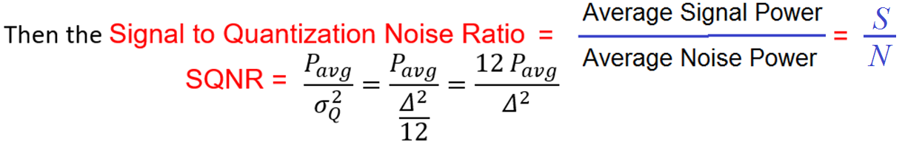
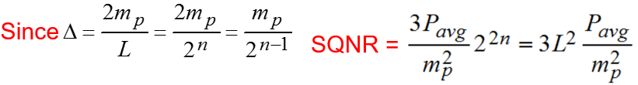
Signal to Quantization Noise Ratio

Slide 19
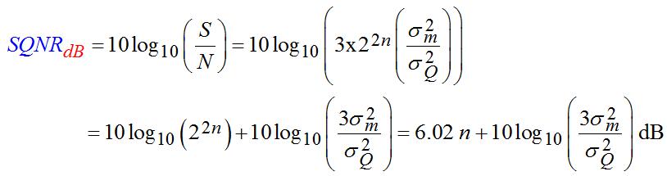
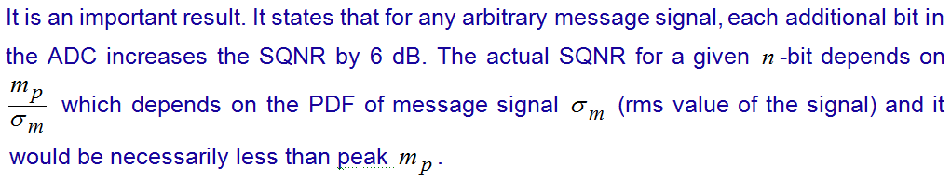
6 dB rule

Slide 20
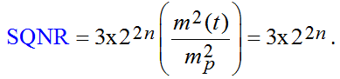
Case1:

Slide 21
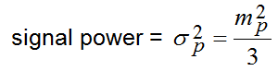
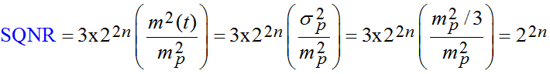
Case2:

Slide 22
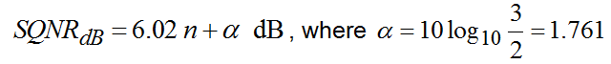
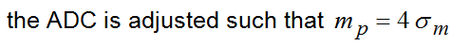
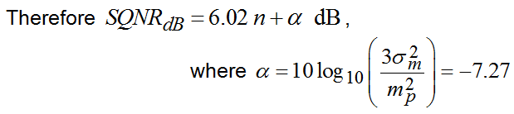
Case3:
Case4:

Slide 23
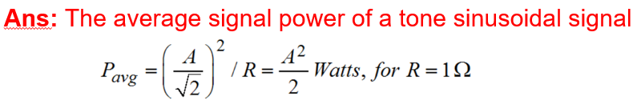
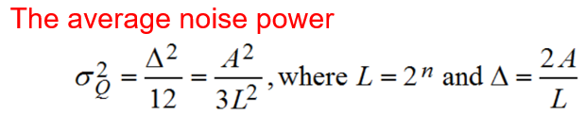
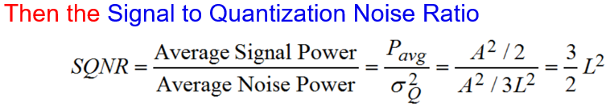
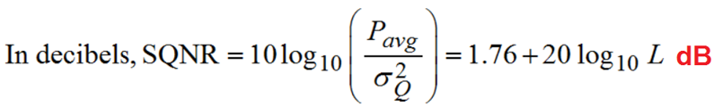
Derive an equation for Signal to Quantization Noise Ratio in the case of a full scale sinusoidal message signal with amplitude A volts.

Slide 24
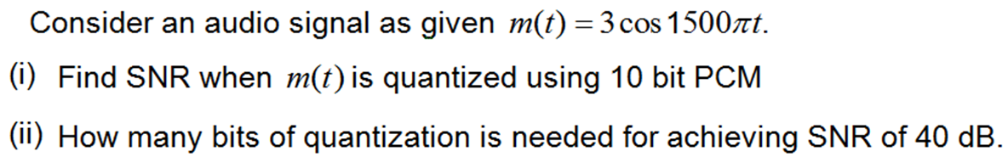
(i) Signal Power
Noise Power

Slide 26
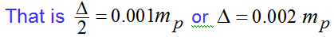

Slide 27
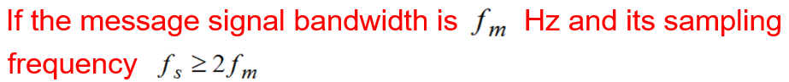
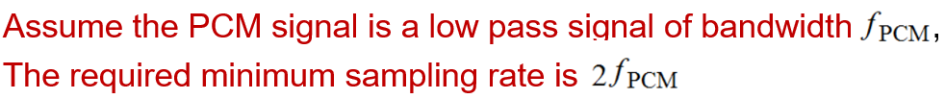
Bandwidth of PCM

Slide 28








Slide 29

In a binary PCM system, the output SQNR is to be held to a minimum of 40 dB. Determine the of required levels, and find the corresponding output SQNR.

Slide 30



Slide 32




n= 5.6 approximately 5; Sampling frequency 7.2 KHz

Slide 33
Problem Solving
A signal that has the highest frequency component of 4.2MHz and a peak to peak value of 4 volts is transmitted using a binary PCM. The number of quantization levels is 512 and P=0.04W calculate:
Code word length.
Bite rate.
Output signal to quantization noise ratio.
a. 9 b. 75.6X10⁶ bits/sec c. 1966.08 i.e 33dB

Slide 34

What happens with a weak signal?
Problem with uniform Quantization:
Only optimal for uniformly distributed signal
Real audio signals (speech and music) are more concentrated near zeros
Human ear is more sensitive to quantization errors at small values
What can we do to minimize this problem?
1.Non uniform/Adaptive quantization or
2. Companding

Slide 35

Non uniform quantization
Output sample
X_{Q}
6
4
2
-8
-6
Input sample
X
-4
-2
2
4
6
8
-2
-4
-6
Example: Nonuniform 3 bit quantizer

Slide 36




Companding

Slide 37

Companding Laws
A-law | µ-law
Uniform quantization is achieved at A = 1 | Uniform quantization is achieved at µ = 0
Mid-rise | Mid-tread
Used for PCM telephone systems | Used for speech and music signals(only used in Canada and Japan)

Slide 38
For a compressor using µ law compander with a µ=255, Plot the characteristics and Determine
The voltage gain for the following relative values of V_{in} to V_{max}
The compressed output voltage for a maximum input voltage of 4V.
Dynamic range
V _{signal max} | V_{in}
V_{sig} | = 0 V_{max}
V_{max} | = 0.2V_{max}
V_{max} | = 0.4V_{max}
V_{max} | = 0.6V_{max}
V_{max} | = 0.8V_{max}
V_{max} | = V_{max}
V _{signal max} | Vout
V_{max} | = 0 V_{max}
V_{max} | = 0.71V_{max}
V_{max} | = 0.84V_{max}
V_{max} | = 0.9V_{max}
V_{max} | = 0.96V_{max}
V_{max} | = V_{max}
Input =12db; Output=2.5dB

Slide 39
Level coding
Need for Level coding
Explanation with an example.

Slide 40

Representation of PCM Code

Slide 41

Regenerative repeater

Slide 42

Receiver

Slide 43
Advantages and Disadvantages
Advantages
Robustness to channel noise i.e Very high noise immunity
Efficient exchange of SQNR for increased band width.
Regenerative repeater.
Possibility for storage due to its digital nature.
Possible for coding and uniform format for different kinds of base band signals.
Disadvantages
Complexity of receiver
Larger bandwidth requirement as compared to its analog counterparts.

Slide 44
Applications
Used in telephony
Used in space communications with low power and high noise immunity.
Used in Digital Audio Applications and CD recording

Slide 45


Encode the following
Quantization level | Code | X1 | Code | X2 | Code
-3.75 | 0000 | -2.55 | 0001 | -0.753 | 0110
-3.25 | 0001 | -2.2 | 0010 | -0.053 | 0111
-2.75 | 0010 | -1.53 | 0101 | -0.01 | 1000
-2.25 | 0011 | -0.753 | 0110 | -0.009 | 1000
-1.75 | 0100 | -0.53 | 0111 | -0.008 | 1000
-1.25 | 0101 | -0.1 | 1000 | -0.007 | 1000
-0.75 | 0110 | 0.5 | 1001 | 0.006 | 1000
-0.25 | 0111 | 0.753 | 1010 | 0.253 | 1001
0.25 | 1000 | 1 | 1010 | 0.1 | 1001
0.75 | 1001 | 1.5 | 1011 | 0.1 | 1001
1.25 | 1010 | 2.5 | 1101 | 0.2 | 1001
1.75 | 1011 | 3 | 1110 | 0.1 | 1001
2.25 | 1100 | 1.5 | 1011 | 0.2 | 1001
2.75 | 1101 | 0.5 | 1001 | -0.1 | 1001
3.25 | 1110 | -1 | 0110 | -0.2 | 1001
3.75 | 1111 | -2.253 | 0010 | -0.15 | 1001
Quantize and encode the following signals using PCM, if Vmax= 4V and a 4 bit code is used.
Sequences
X1={-2.55, -2.2,-1.5,-0.75,-0.5,-0.1,0.5,0.753, 1,1.5, 2.5,3,2,1.53, 1,0.5,-1,-2.253,-3,-3.5, -2,-1.5 }
X2=[-0.753,-0.05,-0.01,-0.009,-0.008,-0.007,
-0.007, -0.006,0.253,-0.1,0.1,0.2,0.1,0.2,-0.1,-0.2]

Slide 46
DIFFERENTIAL PCM
Let m[k] be the k^{th} sample of signal m(t). Then we can express the difference between adjacent samples as
d[k] = m[k] – m[k-1]
Instead of transmitting m[k], can we transmit d[k]?
If Yes..What is the advantage?
Is it possible to reduce the data to be transferred?

Slide 47

DPCM
Modulator or Encoder
e_{q(}nT_{s})= e(nT_{s})+ q(nT_{s})
q(nT_{s}) is quantization error
e(nT_{s})+ x^( nT_{s}) = x(nT_{s})
e(nT_{s})= x(nT_{s})- x^( nT_{s})
x_{q}(nT_{s}) = x(nT_{s})+ q(nT_{s})
This implies that the prediction signal is in fact equal to the sum of the input sample plus quantization noise. The loop predicts the input accurately.
x_{q}(nT_{s}) = x^(nT_{s})+ e_{q}(nT_{s})
x_{q}(nT_{s}) = x^(nT_{s})+ e(nT_{s})+ q(nT_{s})

Slide 48

Receiver
S. NO | Parameters | Pulse Code Modulation (PCM) | Differential Pulse Code Modulation (DPCM)
1 | Number of bits | It uses 4, 8, or 16 bits per sample | < PCM bits
3 | Bit redundancy | Present | Can permanently remove
4 | Quantization error and distortion | Depends on the number of levels used | Quantization noise is present, but very less as compared to PCM
5 | Bandwidth | Higher bandwidth required | Lower than PCM bandwidth
6 | Feedback | No feedback in Tx and Rx | Feedback exists
7 | Complexity of coder | Simple | Complex
8 | SNR | Good | Fair
9 | Area of application | Audio, video and telephony. | Speech and video.
10 | Bits/sample | 7 to 8 | 4 to 6
11 | Bits rate | 56-64 | 32-48
Parameter | PCM | DPCM
Magnitude | V_{max} | d_{max}(<< Vmax)
No of levels | L | L
Step size | ∆=2V_{max}/L | 2d_{max}/L
Noise Power (∆²/12) | 2V²_{max}/L² | 2d²_{max}/L²
SNR | V_{rms}²/(2V²_{max}/L²) | v_{rms}²/(2d²_{max}/L²)
Can we improve SNR using DPCM than PCM?
Yes.
How?

Slide 49



Delta Modulation(DM)
Modulator

Slide 50

Noise (Slope over load distortion& Granular Noise)

Slide 51

Estimate the sampling rate required to avoid slope over load error of a sinusoidal signal?

Slide 52

Noise
Slope Over load:
Condition to avoid it
Granular
Find the minimum sampling frequency to avoid slope over load error when x(t)= cos(1600 π t), if δ=0.1.
Ans: 50k
Find the minimum sampling frequency to avoid slope over load error when x(t)= 6 sin(2000 π t)+ 4 sin(4000 π t), if δ=0.314V.
Ans: 280k/s

Slide 53
SQNR
Condition to avoid slope overload distortion
For a sinusoidal signal of
The maximum power of the signal
Noise power of quantization
In band noise power
SQNR

Slide 54
DM Detector
LPF
O/p
I/p
Delay

Slide 55
Advantages and Applications of DM
Advantages
Low bandwidth consumption and large signaling rate
High SQNR
Providing feedback on data delivery
Implementation of Xmitter and Receiver are easy
Applications:
Used in coding at low frame rate applications.
Used for voice coding.

Slide 56

Adaptive Delta Modulation
Adaptive Step Size
Logic for step size control
Uniform Step Size
One bit quantizer
Input
Output
Delay

Slide 57
ADM Detector
LPF
o/p
I/p
Logic for step size control
Delay

Slide 58
Advantages of ADM
Signal to noise ratio of ADM is better than that of DM.
Dynamic range of ADM is wider than DM due to variable step size.
Utilization of bandwidth is better in ADM than DM.

Slide 59


